Slide 1

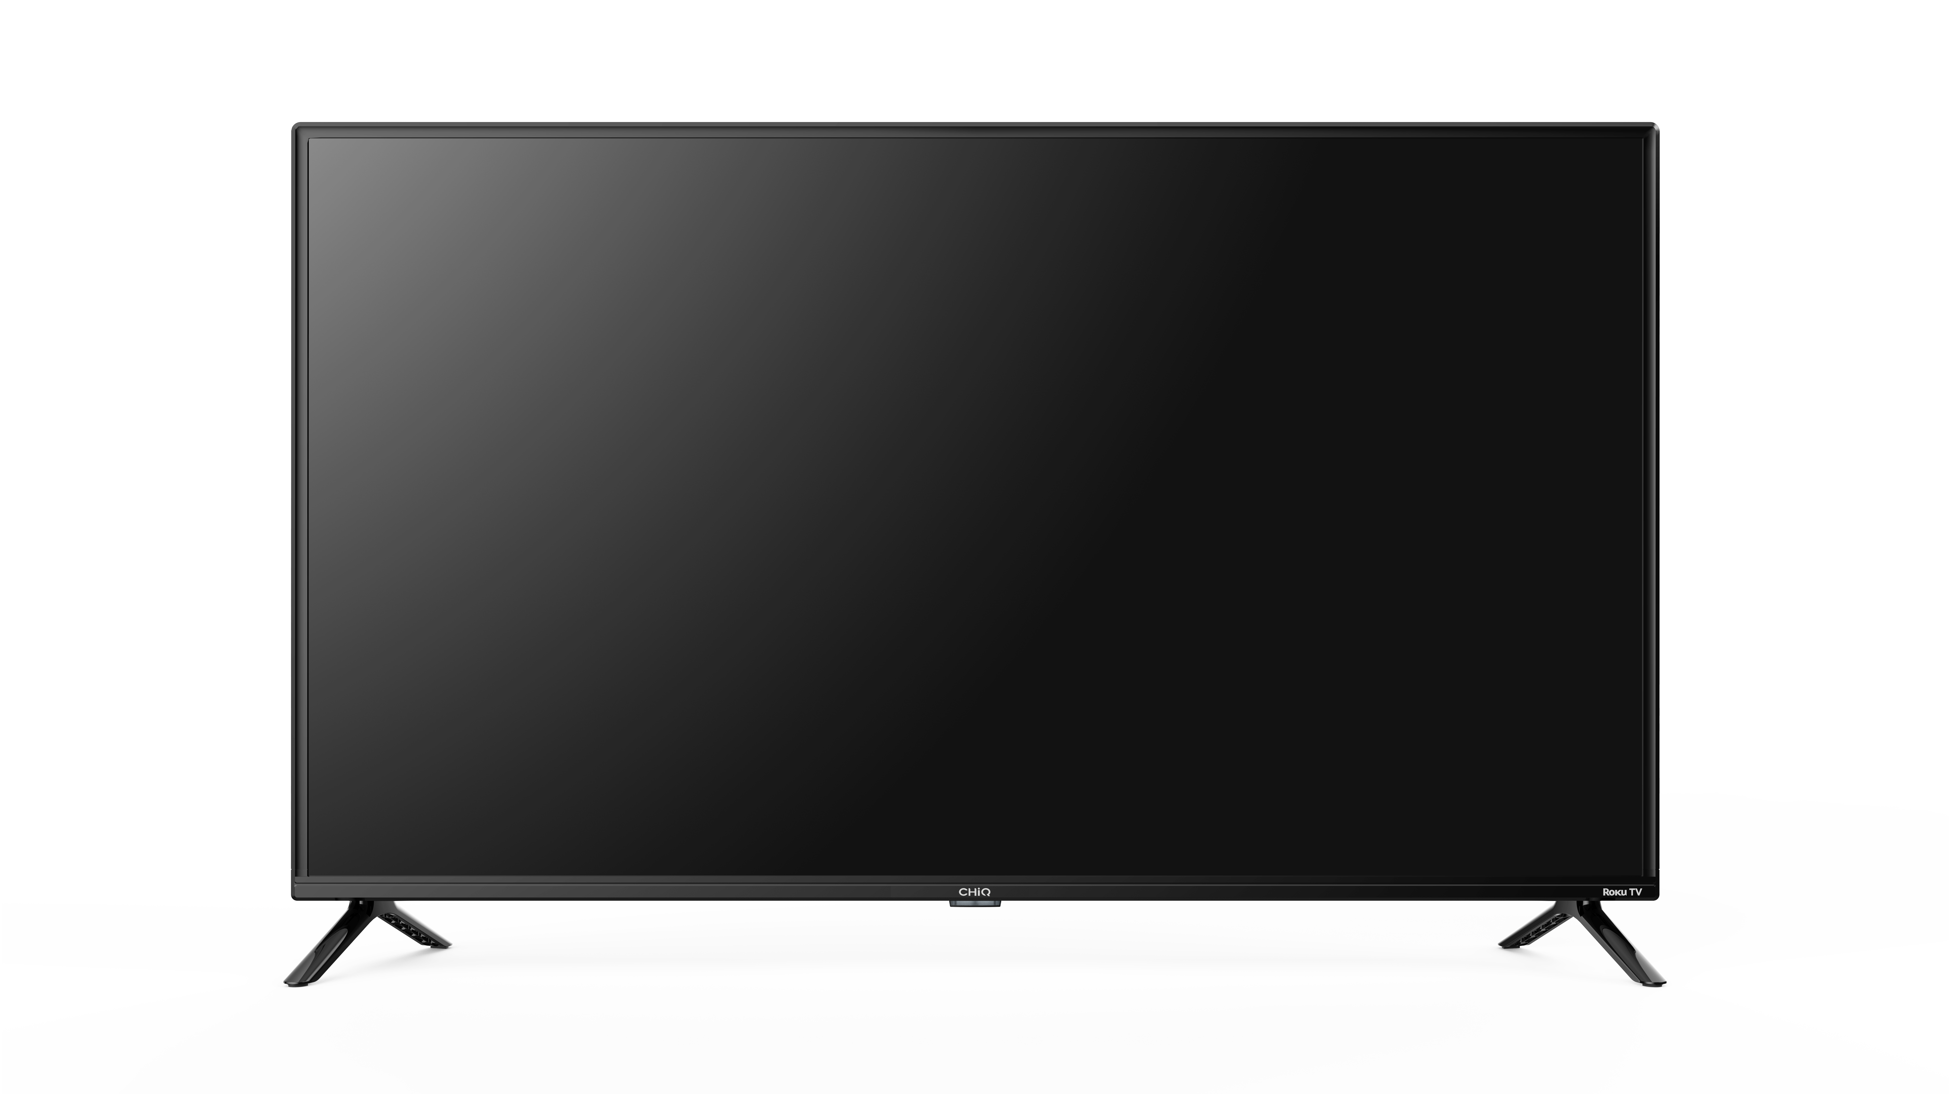
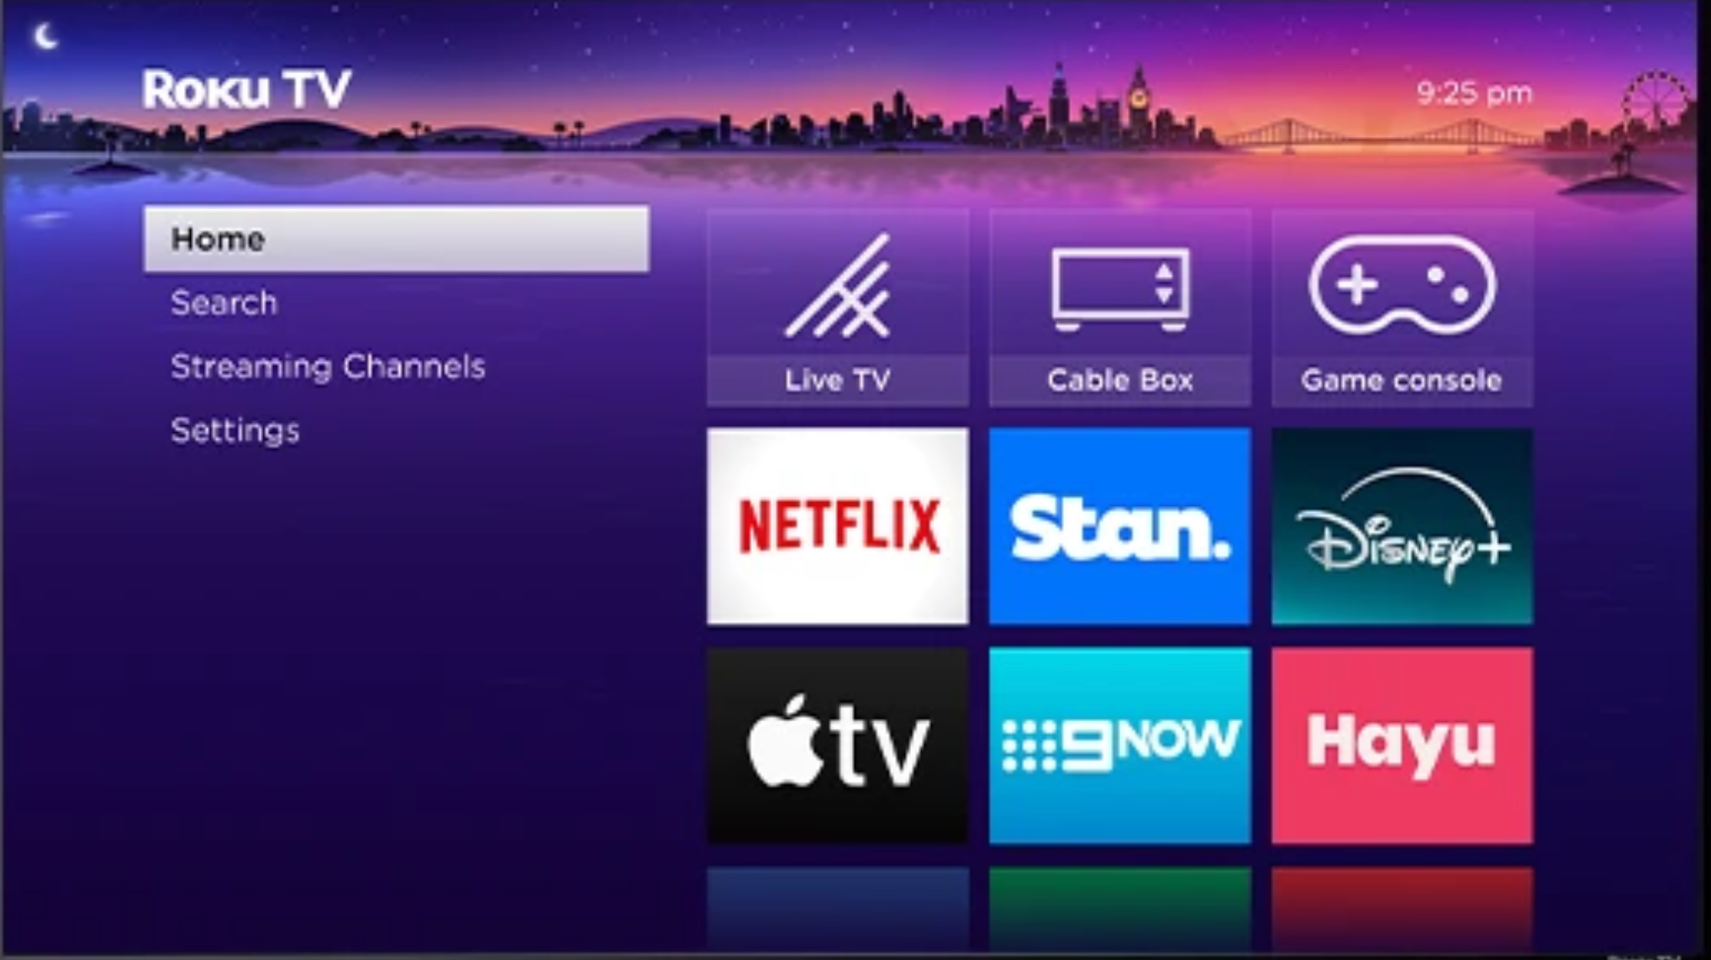












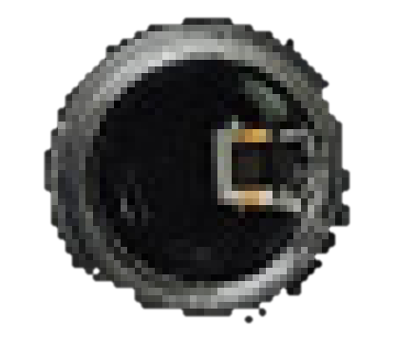
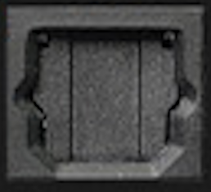



PRODUCT SPECIFICATION
2025
MODEL L40G5AU
SELLING POIINTS
2.4G+5.0G
DISPLAY
AUDIO
Screen Size | 40”
Aspect Ratio | 16:9
Resolution | 1920*1080
Luminance | 220 cd/m²
Contrast | 5000:1
Display Color | 16.7M
Screen View Angle | 178°/178°
Response Time | 9.5ms
HDR | HDR10/HLG
PSI | No
MPEG-2 | Yes
MPEG-4 (H.264) | Yes
Refresh Rate (Hz) | 60Hz
Progressive Scan | Yes
3D Comb Filter | Yes
Audio Output | 2*8 | Watt
Dolby Audio/Dolby+ | Yes | /
Stereo | Nicam/A2 | /
Automatic Volume Limiter | Yes | /
Noise Reduction | Yes | /
DIMENSIONS / WEIGHT
Dimensions with stand | 904.3*180.1*563 | mm
Dimensions without stand | 904.3*80.3*516 | mm
Packaging | 1025*135*635 | mm
Net / Gross Weight | 5.7 / 7.7 | kg
Packaging level | A | /
WALL MOUNT
Wall Support Type | 200 x 200 | mm
Screw | M6 | /
DESIGN
MEDIA FORMAT
DESIGN
Video | MP4,MKV,MOV,AV1
Audio | MP3,WAV(PCM),AIFF,FLAC,AAC(5.1),OGG,AC3
Image | JPEG、PNG、BMP
Frameless Design | No
Screen Shape | Flat
Frame Color | Black
Stand Color | Black
Swivel Stand | No
INPUT / OUTPUT
HDMI1.4 | HDMI1.4 | AV Input | Audio Output |  | Data Transfer
HDCP 1.4 ARC CEC | HDCP 1.4 CEC | Mini | Earphone | Digital Audio Out | USB 2.0 5V, 500mA | LAN | ANT
x1 | x2 | x1 | x1 | x1 | x1 | x1 | x1
EAN No.: 6937555211190

Slide 2

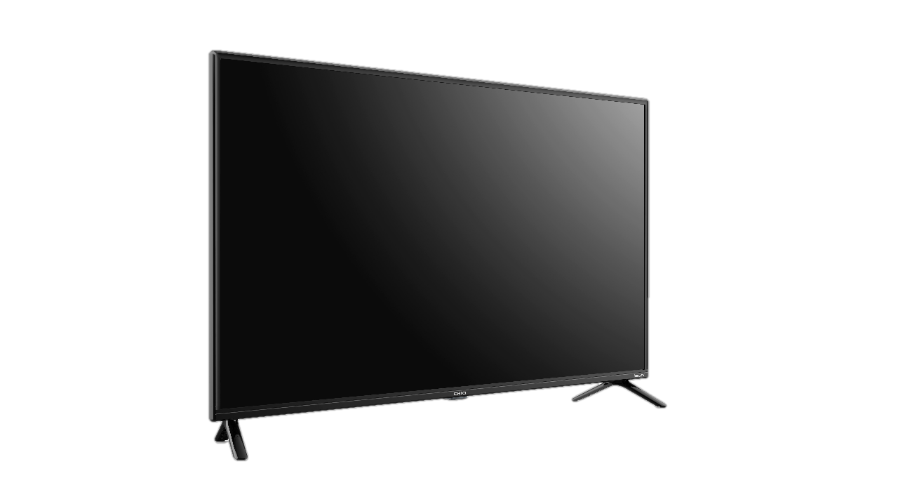
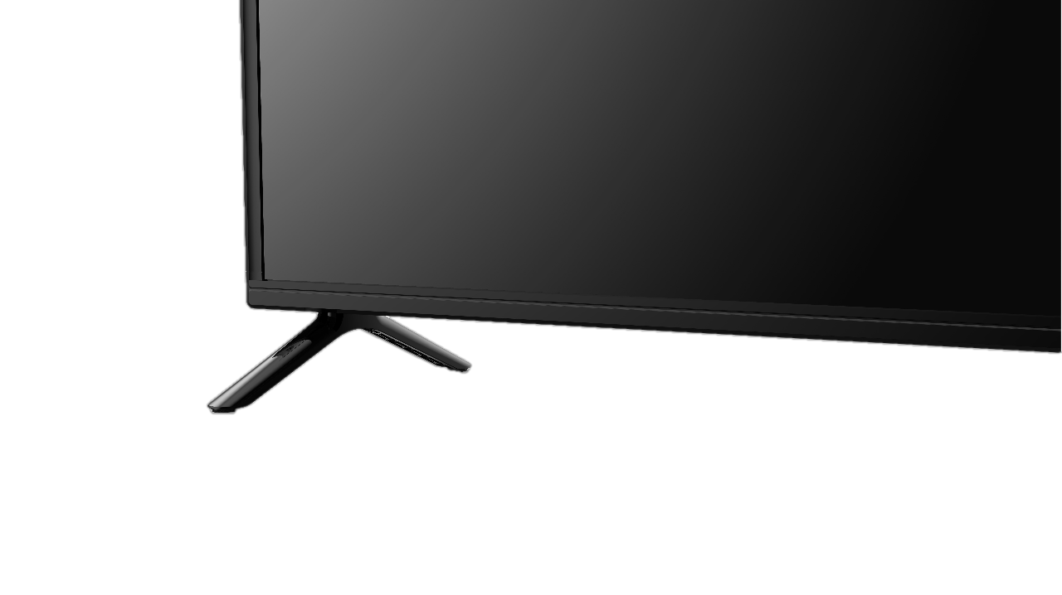

PRODUCT SPECIFICATION
2025
MODEL
L32G4000
PRODUCT PHOTOS
DETAILS
FEATURES
SMART FUNCTION
CI+(CI Plus) / CA-System | NO
E-manual | Yes
Guest Mode | Yes
OSD Language | EN, FR, DE, PT, ES
Software upgrading | Yes
Parental Lock | Yes
Sleep-Timer | Yes
ARC | Yes
eARC | NO
CEC | Yes
USB Media Player | Yes
USB Clone Function | NO
Teletext | NO
Quad Core | Yes
HbbTV | Yes
Works with Google Home | Yes
Works with Apple Home | Yes
Works with alexa | Yes
Chromecast / Airplay | • (RTN active)
App Store | Roku Store
WIFI | 2.4G&5G
ENERGY CONSUMPTION
Energy Rating | Six Stars
On-Mode Power Consumption | 60W
Annual Energy Consumption | /
Stand-by Power Consumption | ≤ 0.5W
Off-Mode Power Consumption | < 0.01W
AC Power Supply | AC 100-240V,50/60Hz
EAN: 6937555211190
www.chiq.com.au

